Slide 1
Collection Site Oversight & Mock Collections
Ensuring Your Site is Doing it Right
FTA NATIONAL CONFERENCE
Milwaukee 2019

Slide 2
Questions
(For you)

Slide 3
How many of you…
Have had an employee with a drug test violation win an arbitration due to an error at a collection site or on the paperwork?
Review your drug & alcohol testing paperwork regularly?
Have inspected or conducted mock collections at your collection sites?

Slide 4
Overview
The Who, Why, What, and How of Collection Site Oversight

Slide 5
We will discuss:
Your responsibility as an employer
Why oversight is important
Ways to monitor your collection site
In-house
On-site

Slide 6
Oversight: Whose Responsibility is it Anyway?
The employer’s!

Slide 7
49 CFR Part 40.11(b)
As an employer, you are responsible for ensuring that DOT regulations are carried out by:
Your officials
All representatives of your company
Service agents

Slide 8
Why is Oversight Important?
Public Safety is our goal!

Slide 9
Ensure the Strength of the Testing Process

Slide 10
Ensure the Security of the Testing Process

Slide 11
Ensure the Integrity of the Testing Process
“Integrity
is doing the right thing,
even when no one is
watching.”
CS Lewis

Slide 12
Help to Ensure Our Ultimate Goal
Strength
Security
Integrity
Public Safety

Slide 13
What’s the Best Way to Monitor a Collection Site?
Figure out what works for you

Slide 14
In-House

Slide 15
In-House Oversight
Review Alcohol Testing Forms (ATF)
All employer information should be filled out and up-to-date
Confirmation result of 0.02 or higher requires immediate contact
Printout is attached to the form in a tamper-evident manner
Result is written only when the EBT does not have a printer and only for the initial screening
Confirmation test must be machine-printed
Correct date and time
Alcohol test completed before the drug test (if both tests conducted)
Receiving legible Copy 1?

Slide 16
DOT Alcohol Testing Form (ATF)

Slide 17
In-House Oversight
Review Custody and Control Forms (CCF)
All pertinent information is listed
Employee ID # (SSN or company ID)
DOT Agency
Type of Test
Testing Panel
Collection Site information
Sites can become relaxed with filling this out. You know who they are, but the MRO or the lab may not.
Temperature in Range (Yes/No)
Split Specimen (Yes/No)

Slide 18
In-House (CCF review continued)
Observed?
Required for Return-to-duty/Follow-up testing
If not RTD/FU, is the reason listed?
Name of observer if not collector
Collector Information
Legible
Correct date and time
Employee Information
Legible
Correct dates
Shadowing?
Receiving Copy 4?

Slide 19
DOT Custody and Control Form (CCF)

Slide 20
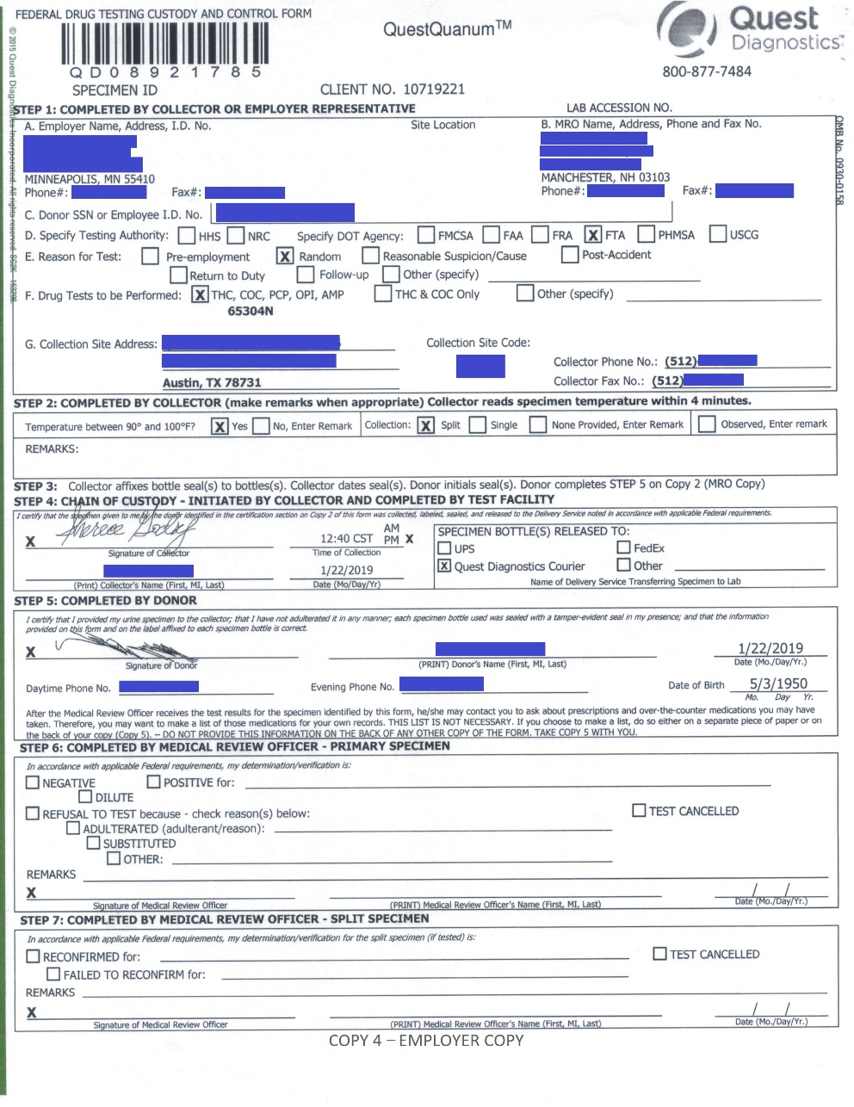
DOT Custody and Control Form (eCCF)

Slide 21
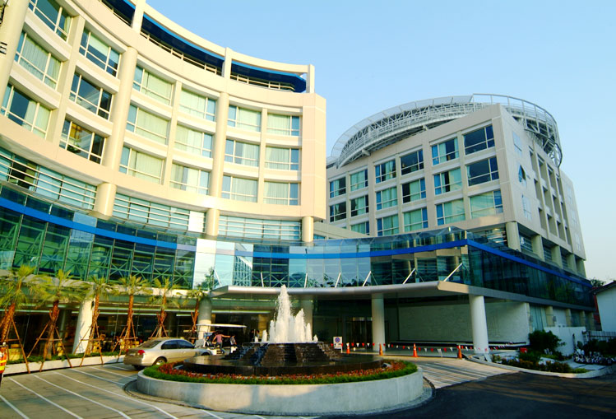
On-Site

Slide 22
On-Site Oversight
Announced Visit/Mock Collection
Set up a time with the site to perform mock drug and alcohol tests
Post-accident is a good test type
Helps build a relationship with the site
Lets the site know you are involved and take the testing seriously
Usually get the site “ringer”

Slide 23
On-site Oversight (continued)
Unannounced
Go in as a donor or accompany an employee
More likely to see what happens on a regular basis
Useful if you are having a number of issues
Regular errors
Site is not addressing items brought to their attention

Slide 24
CCF
Watch the order
Notes:
1- Employee ID/Authority/Agency/Test/Panel 2- Temp/Split 3- Affix seals to bottle and date/EE initials 5 – Employee info 4 – Collector signs

Slide 25
On-site Oversight (continued)
Site Security and Integrity
Is there inappropriate access to the collection area?
In the enclosure:
Is there access to water for the donor during the collection?
Are there areas to conceal items?
Drop ceilings
Cabinets
Toilet tank
Garbage cans
Did the collector secure the area?
Blue water
Remove cleaning products

Slide 26
ODAPC : DOT’s 10 Steps to Site Security and Integrity
Notes:
https://www.transportation.gov/odapc/dot-10-steps-collection-site-security-and-integrity-english

Slide 27
Shy Bladder
Here’s what to check:
Is the donor required to make an attempt prior to fluids being provided?
How is the donor monitored?
Is the amount of fluid being provided measured to meet the regulations?
Does the collector know how to correctly document the three-hour timeframe?

Slide 28
Verify
Check the following:
Collector DOT qualification certificates
Current?
Evidence of Error Correction Training (ECT) if applicable?
Breath Alcohol Technician Certificates
Current and for the device the facility uses?
Quality Assurance Plan for EBT
Calibration Checks
Part 40 & ODAPC List Serve

Slide 29
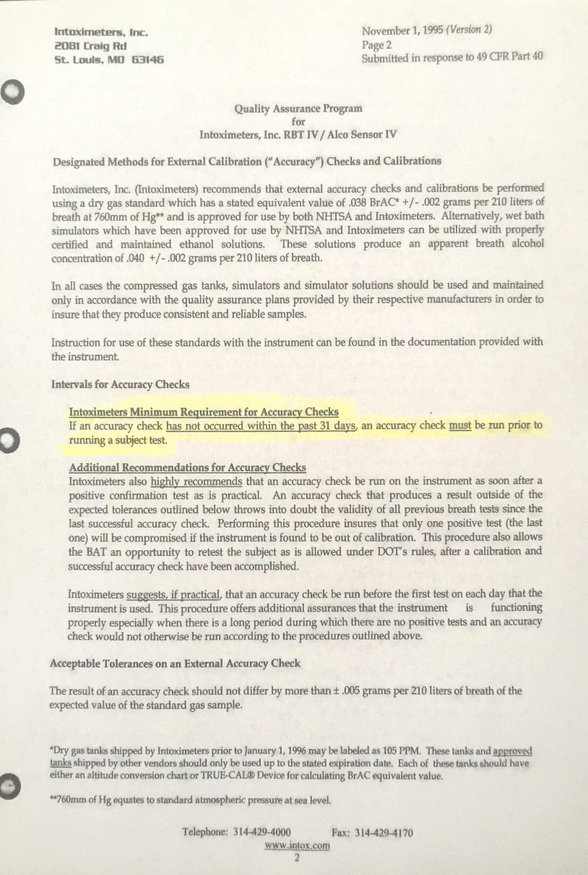
Quality Assurance Plan (QAP)
Notes:
Calibration Checks every 31 days or sooner/Inspected by a certified technician every two years

Slide 30
Calibration Check Log

Slide 31
Review
Let’s make sure you remember what we discussed

Slide 32
Where can Oversight be conducted?
In-House
Review ATFs
Review CCFs
Ensure all information is correct and reach out to the collection site when errors are found
On-Site
Helps to ensure site security and integrity
Helps builds relationship with site and shows your commitment

Slide 33
How can On-Site Oversight be conducted?
Announced
Set up a convenient time for you and your site
Will usually receive the site “ringer”
Unannounced
Go in with an employee or as a donor yourself
More likely to see the site’s regular procedures

Slide 34
What should you look for?
Site Security and Integrity
Is there access to the collection area or specimens?
Enclosure secure?
Is the collector/BAT following the regulations?
Shy bladder procedures
Documentation
Check certificates
Requalified every 5 years
Is proper training conducted?
Error Correction Training (ECT)
Quality Assurance Plan (QAP) for the Evidential Breath Testing Device (EBT)

Slide 35
What do the auditors find?
Findings from FTA's Clandestine Inspection Program

Slide 36
Most common findings from recent inspections
The collector did not explain the procedures on the back of the CCF
The collector wrote the date on the specimen seal labels while they were still affixed to the CCF
The collector did not instruct the donor to wash their hands before the collection took place
Notes:
Explanation of procedures on the back of the CCF must come BEFORE collection
Look for shadows
Hand washing must come before pockets are emptied and must actually be observed

Slide 37
Most common findings from recent inspections
The collector completed Step 4 before the donor completed Step 5
The collector did not complete Step 1
There was no bluing or insufficient bluing in the toilet

Slide 38
More findings
Collector left employee alone during the collection to assist another customer
Collector required the door of a single-toilet bathroom to be left open while the donor provided a specimen
Collector did not direct donor to fill out donor information because collector was unaware of the existence of Step 5 on Copies 2,3,4 & 5.

Slide 39
More findings
A collector conducted the collection. Another collector signed Step 4 of the CCF
Wallet required to be left in an unsecure and unsupervised area

Slide 40
Questions?
These are for us

